Slide 1


ECEN 404 Final Presentation Team 63 AWG Leandro Bracho, Nick Joseph, Oscar Medrano, Robin Smithson Zhewen Hu Dr. John Lusher

Slide 2
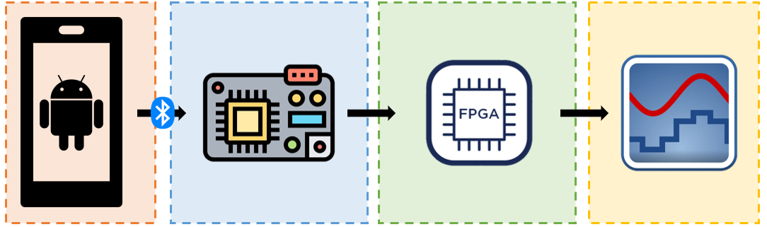
Problem Overview
Project Deliverables
Mobile interface for AWG
Wireless connection
Voltage range: +/- 10 V
Frequency range: 1 Hz – 20 kHz
Up to 65,535 data points
Hand-drawn waveforms
Dual channel
Leandro Bracho | Robin Smithson | Nick Joseph | Oscar Medrano
Android App | MCU | FPGA | DAC
Notes:
Summary of your problem being solved and high level summary of your solution.
About 30 seconds
Robin

Slide 3
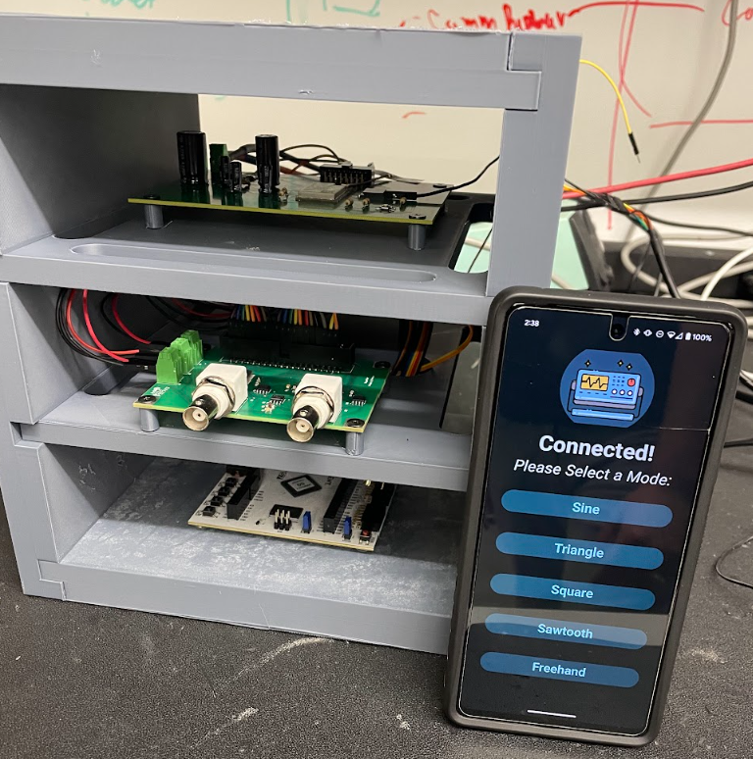
Integrated Project Diagram
MCU
BNC Cable Outputs
Power System (back)
DAC
App Interface
FPGA
Full System Integration
Notes:
Picture (or collection of pictures) or drawing of system • Major components labeled • Show how user connects (ui screens, pictures, etc) • Label major connections/interfaces
30 Seconds
Leandro

Slide 4
Android App Leandro Bracho

Slide 5
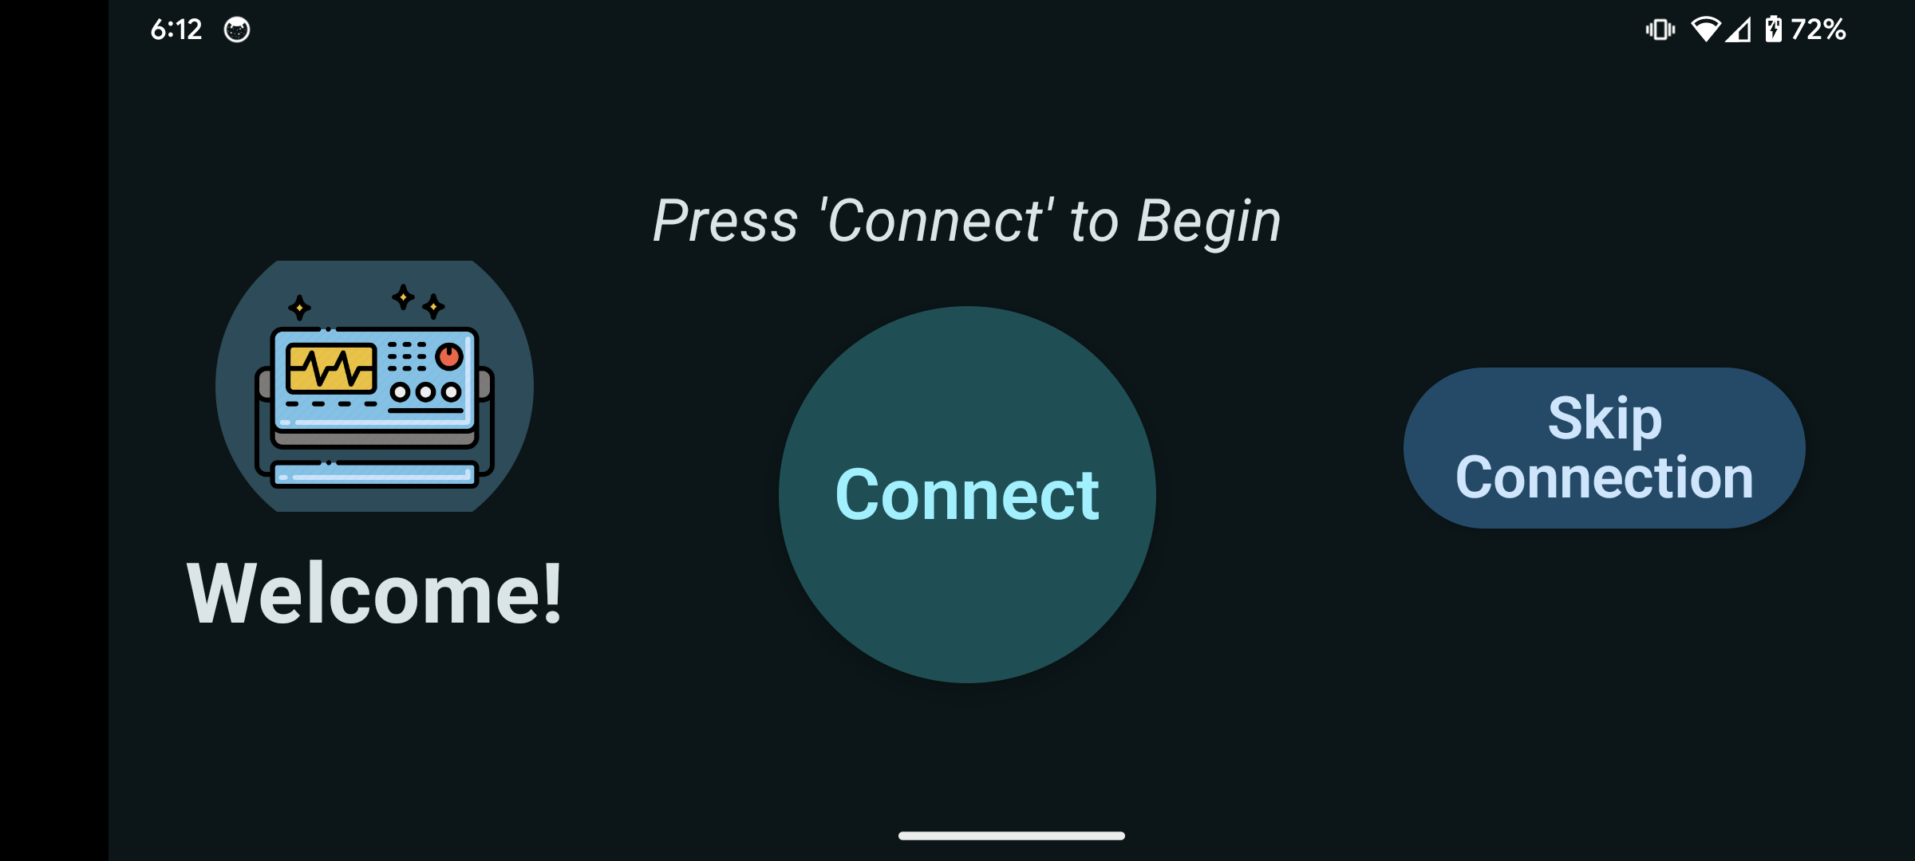
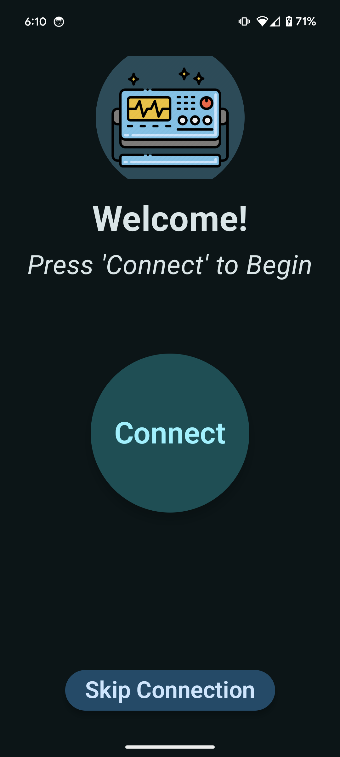
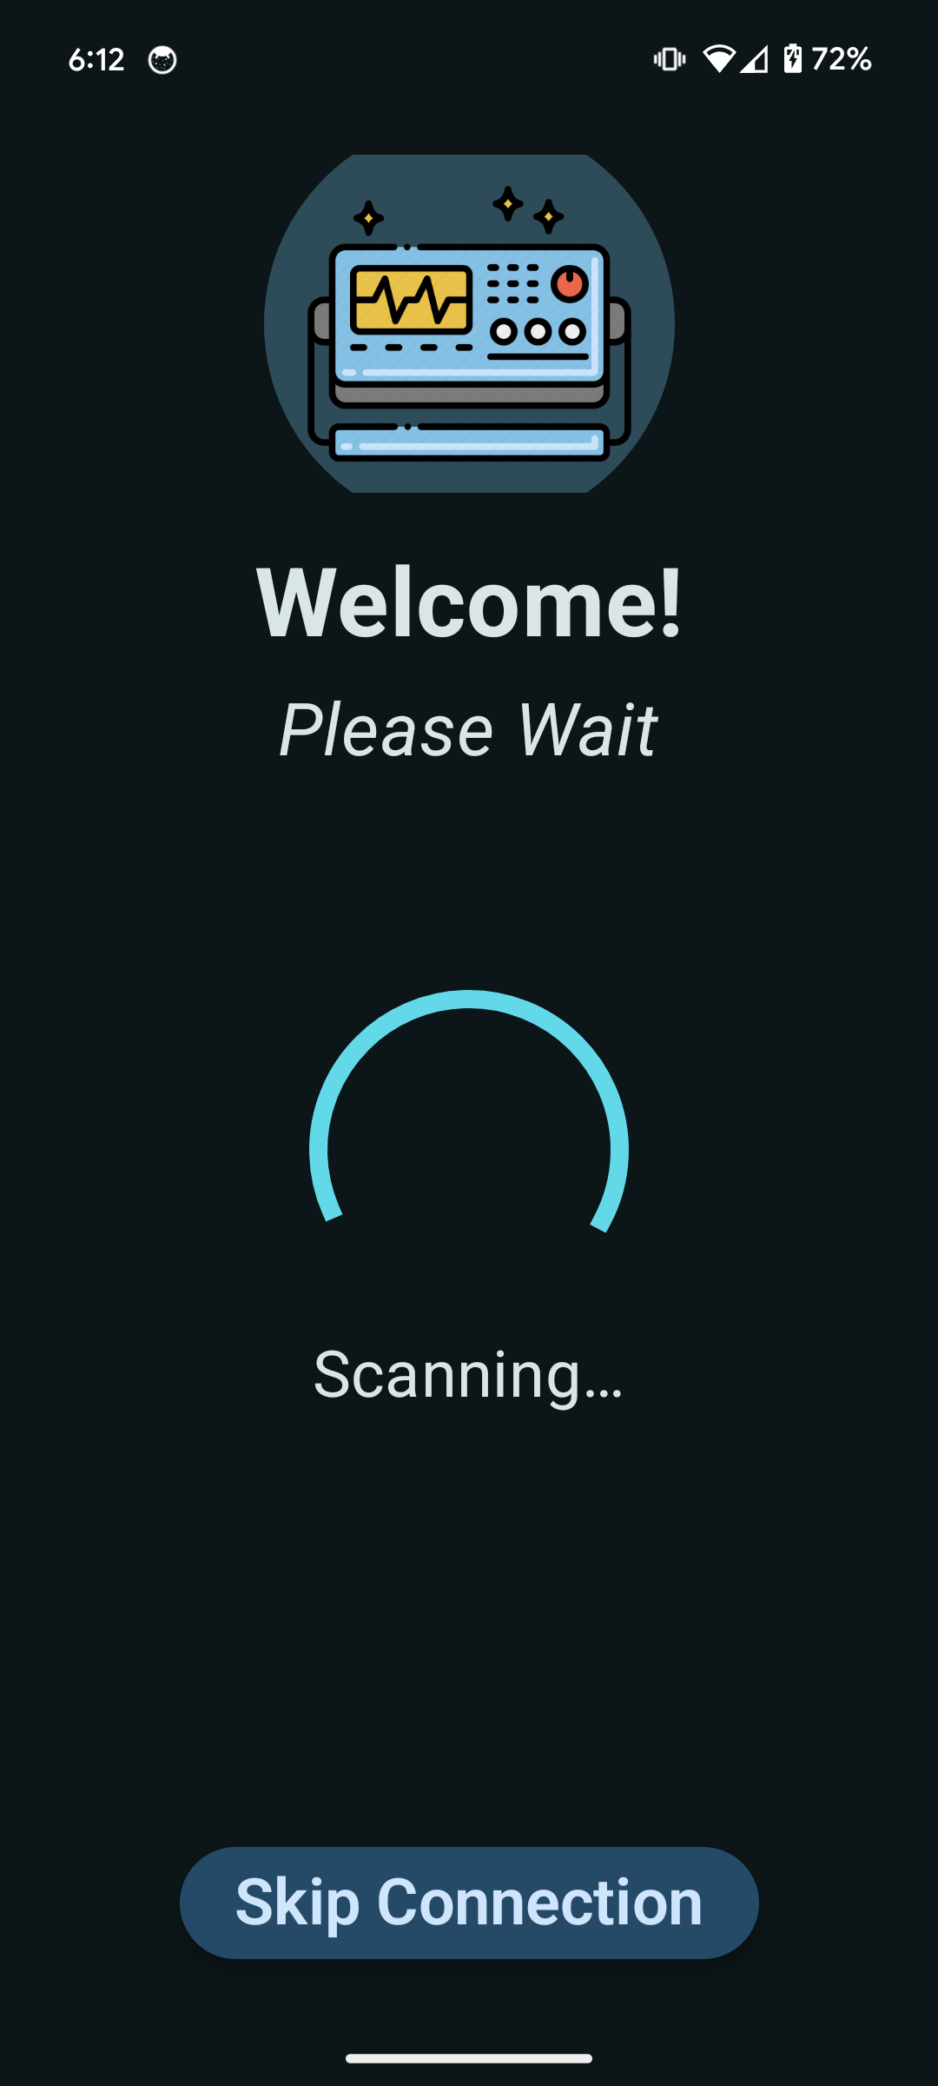
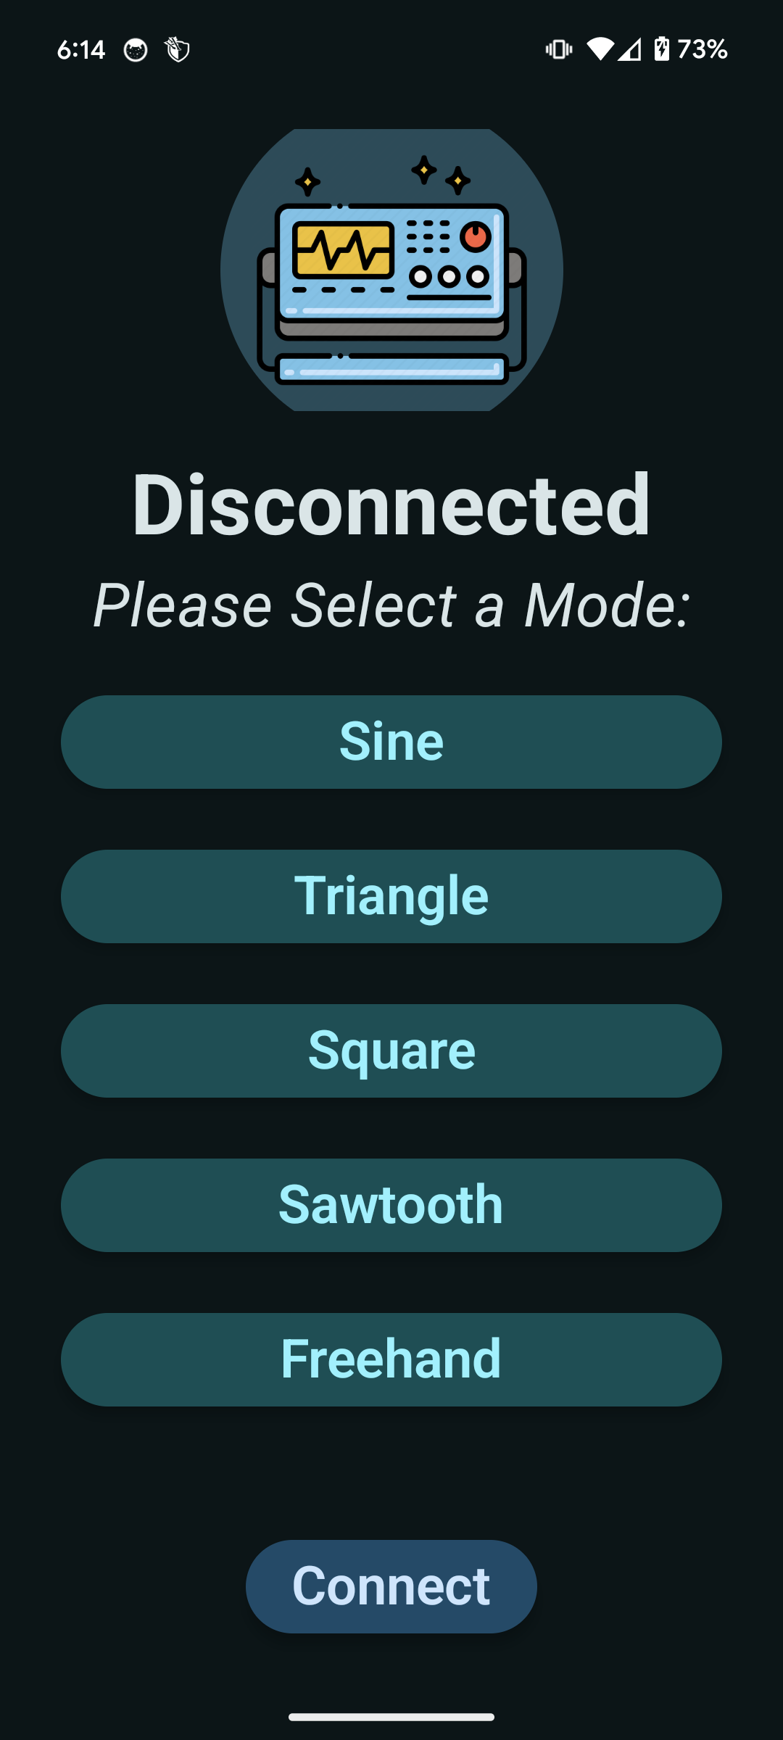
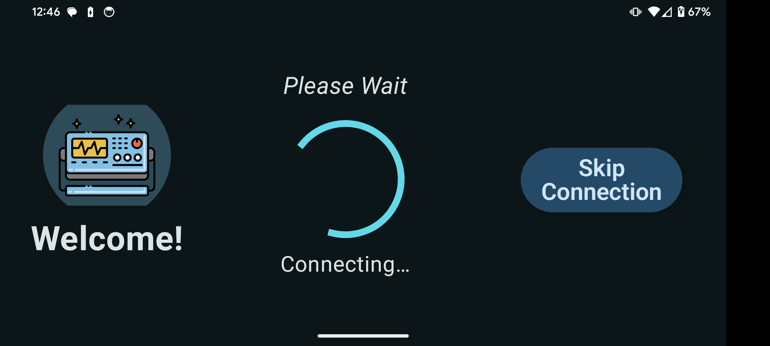
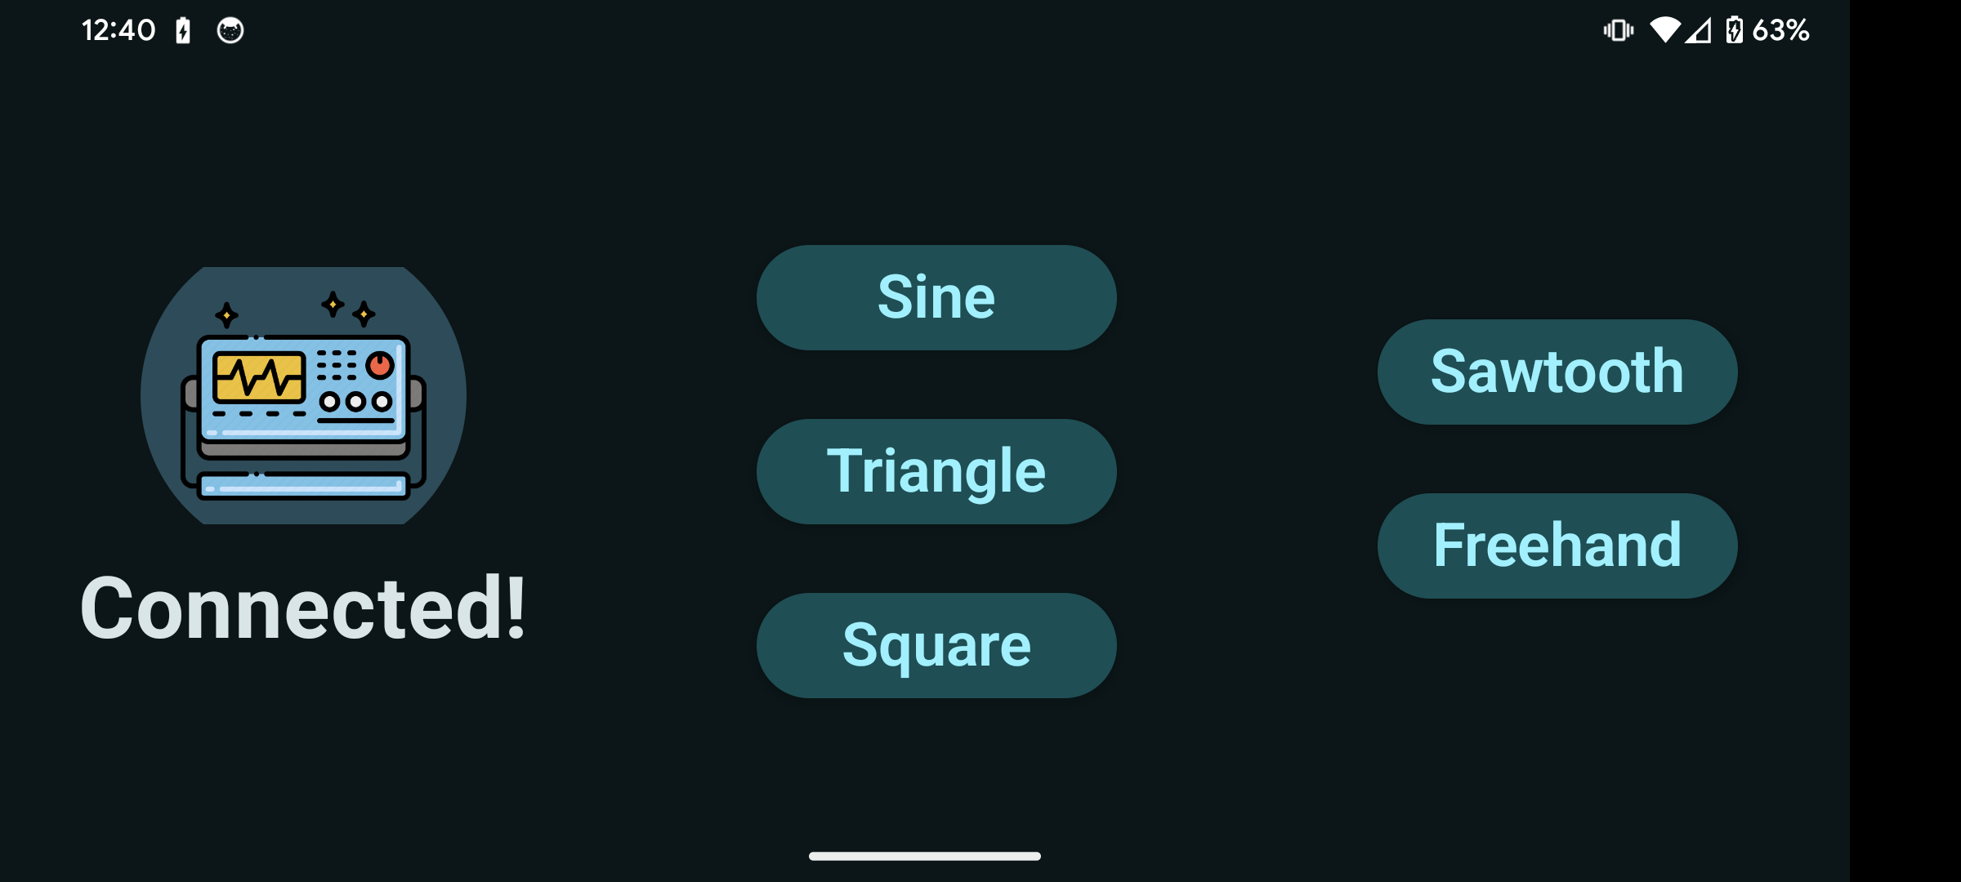
Android Application Accomplishments
First Screen
Scanning
Connection
Horizontal View
Notes:
About 60-90 seconds / team member
Each team member should in 2 – 3 slides show what they designed, tested, and validated.
List challenges / solutions where appropriate.
Present data (table?) with requirement description (eg rover drill placement accuracy); what spec(s) for that requirement (eg mean error in positioning), measured range of results (min 1.2cm, mean 4 cm, max 11cm);
Accomplishments should be backed up with quantitative test results and requirements validation

Slide 6
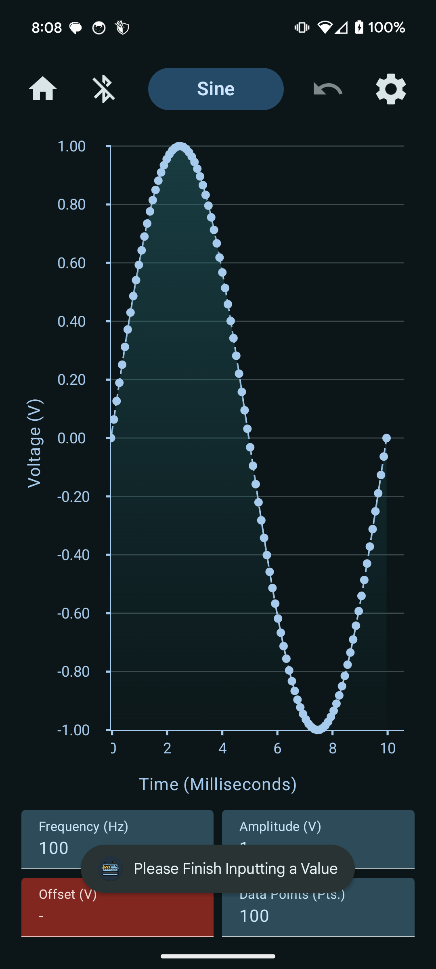
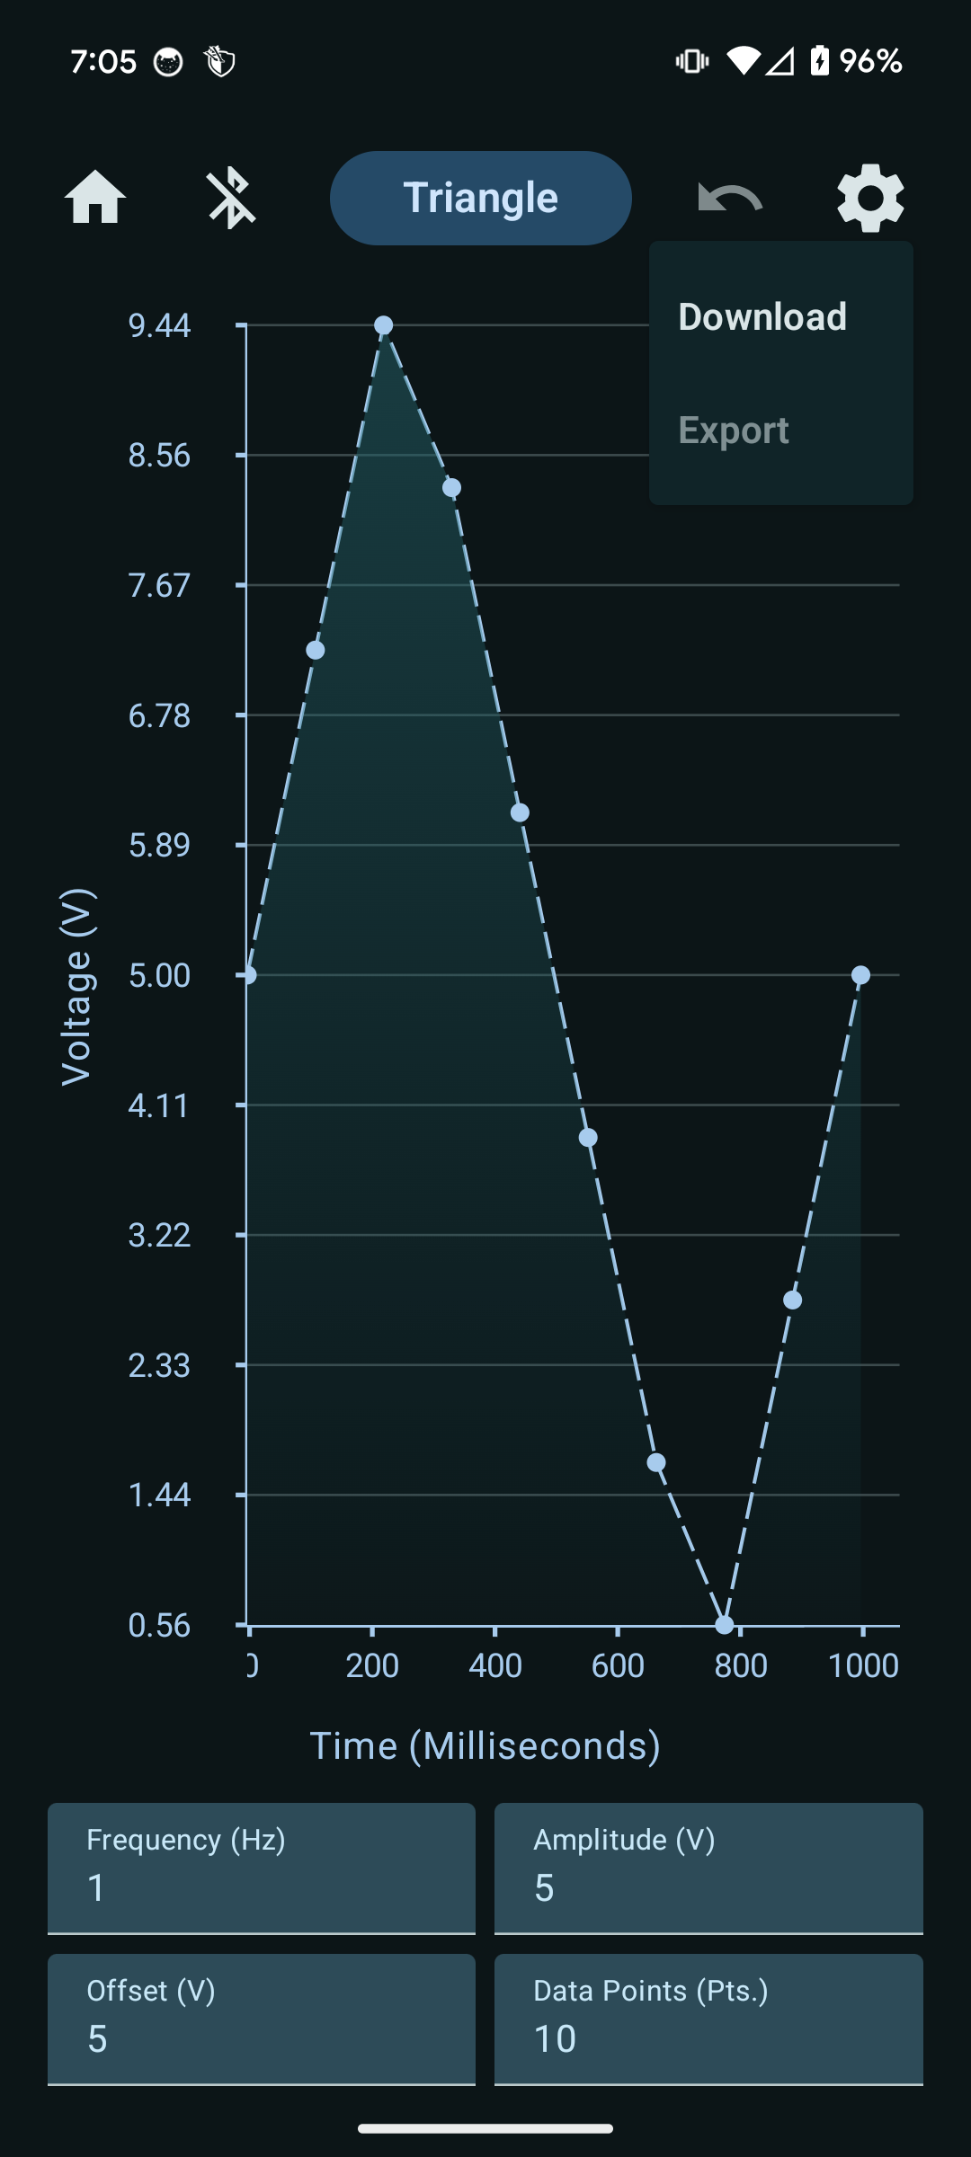
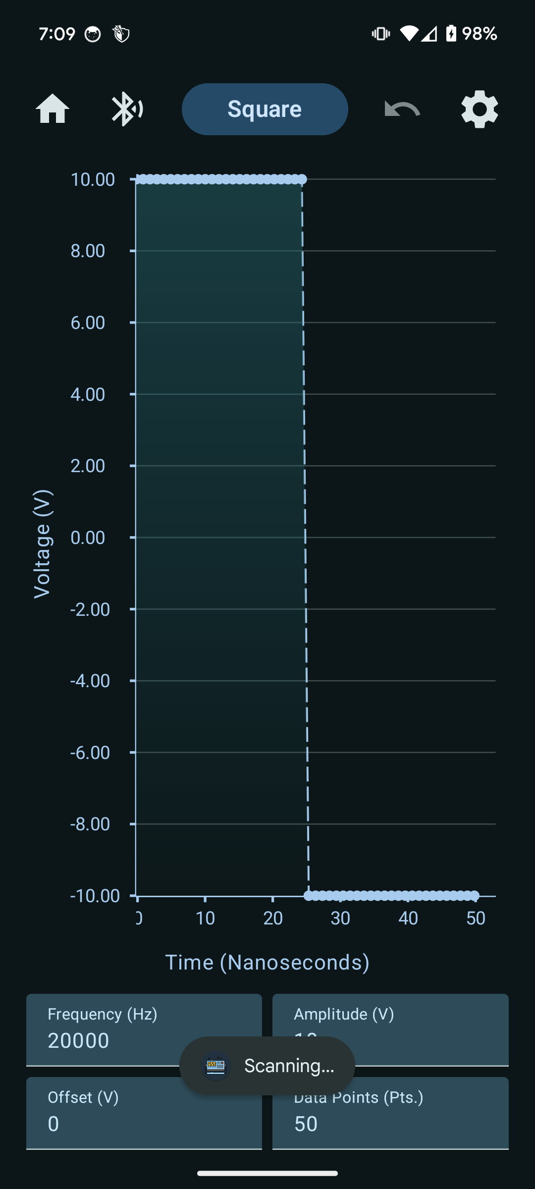
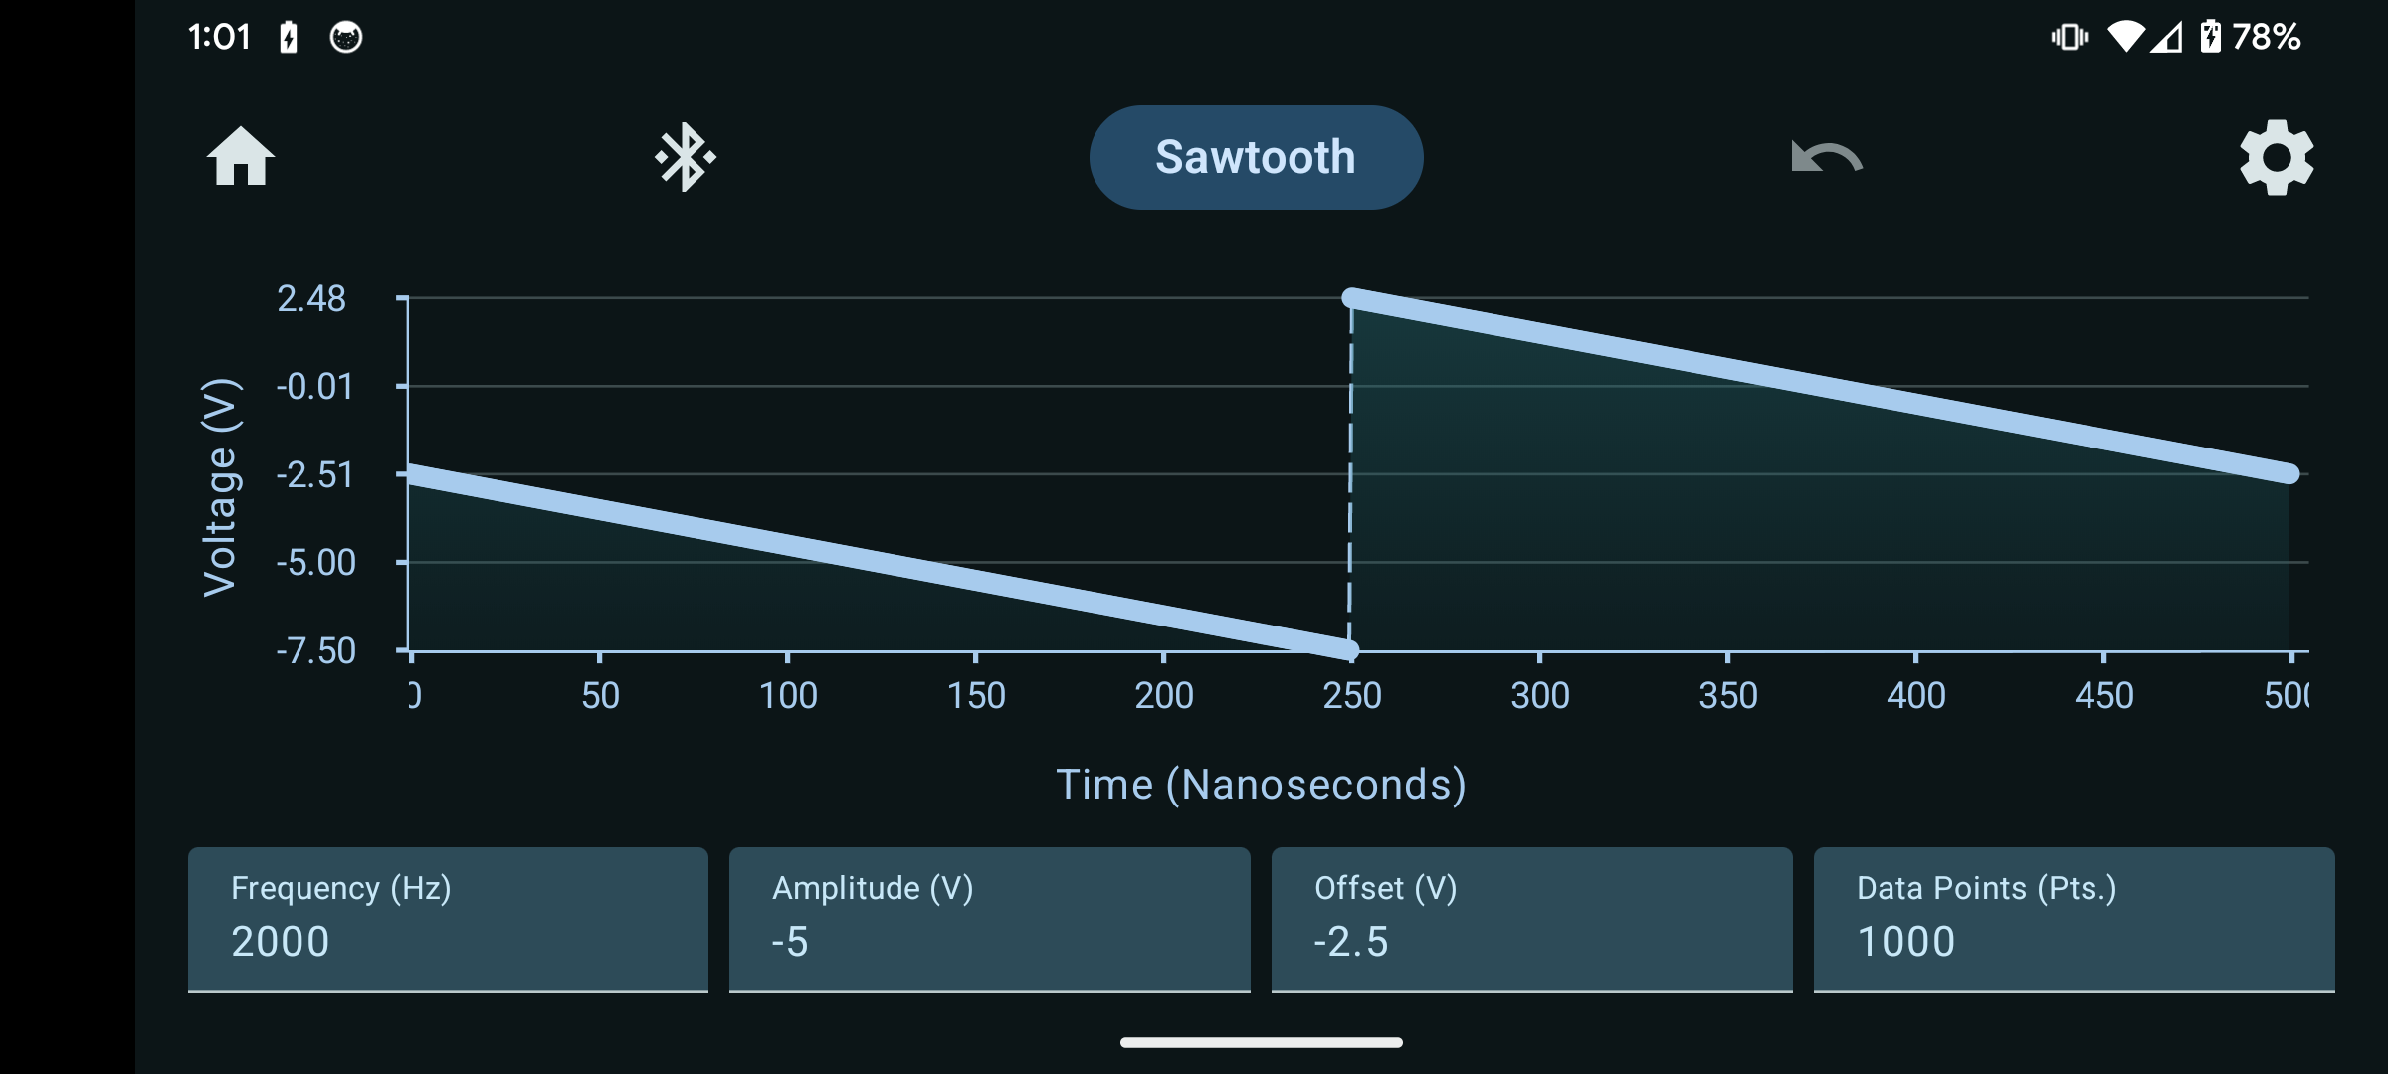
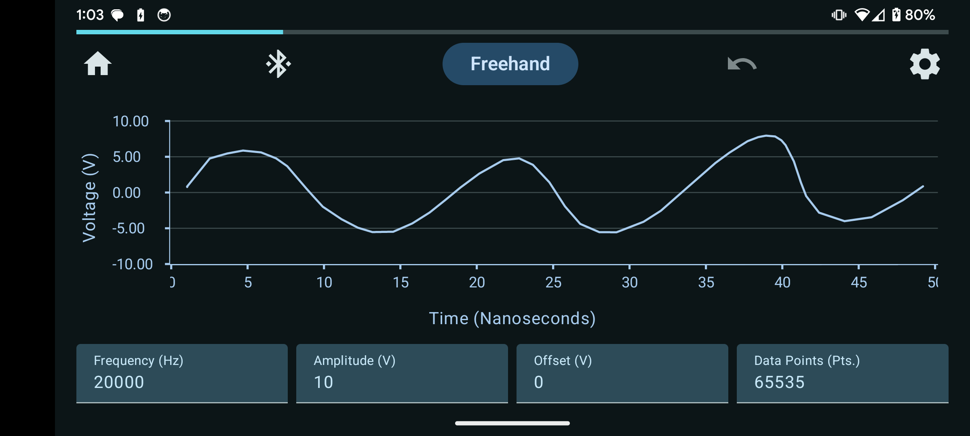
Android Application Accomplishments Cont.
Sawtooth Wave
Sine Wave
Triangle Wave
Square Wave
Freehand Wave
Notes:
About 60-90 seconds / team member
Each team member should in 2 – 3 slides show what they designed, tested, and validated.
List challenges / solutions where appropriate.
Present data (table?) with requirement description (eg rover drill placement accuracy); what spec(s) for that requirement (eg mean error in positioning), measured range of results (min 1.2cm, mean 4 cm, max 11cm);
Accomplishments should be backed up with quantitative test results and requirements validation

Slide 7
Challenges/Solutions
Challenge: Connecting to MCU
Solution: Do not prematurely close connection
Challenge: Export speed
Solution: Display progress bar
Challenge: App freezing during export
Solution: Call functions asynchronously

Slide 8
Microcontroller Robin Smithson

Slide 9
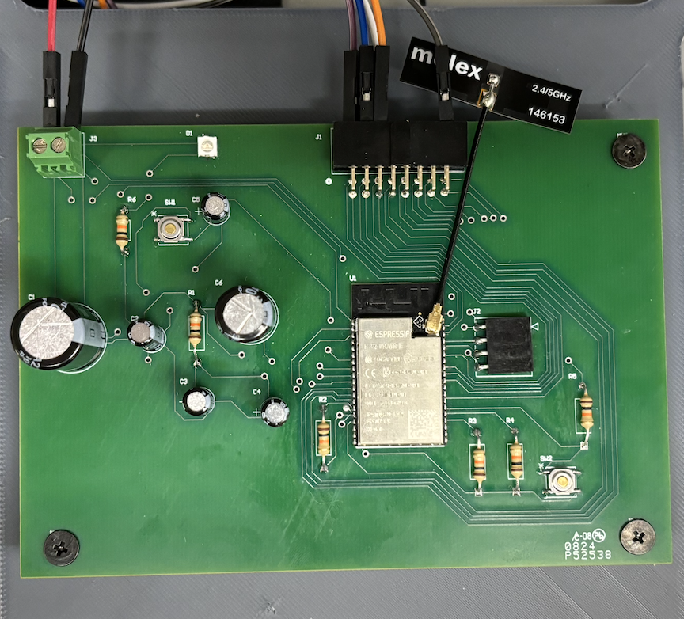
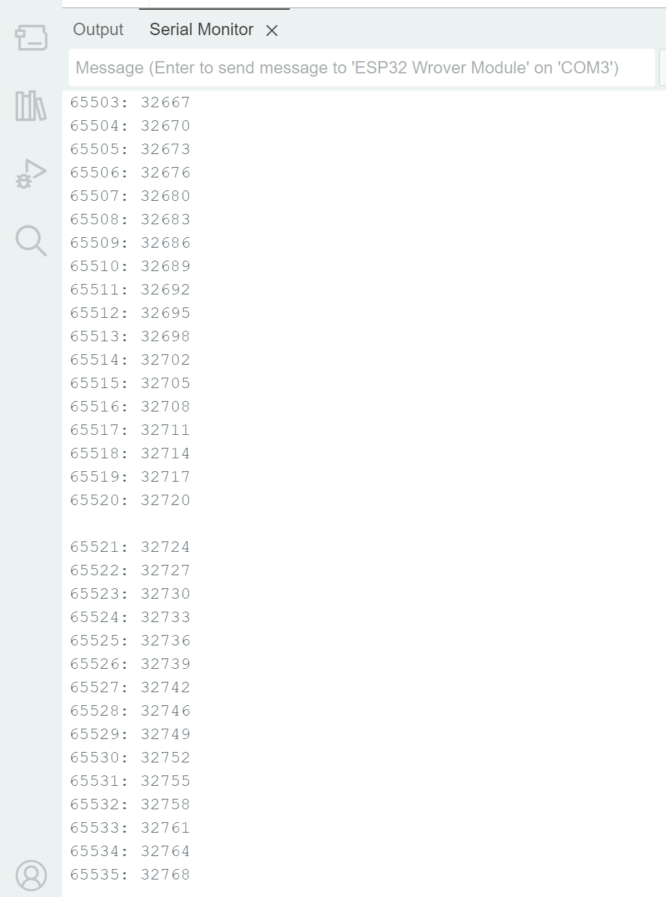
MCU Accomplishments
Final PCB
Total Data Points Imported
Notes:
Each team member should in 2 – 3 slides show what they designed, tested, and validated.
List challenges / solutions where appropriate.
Present data (table?) with requirement description (eg rover drill placement accuracy); what spec(s) for that requirement (eg mean error in positioning), measured range of results (min 1.2cm, mean 4 cm, max 11cm);
Accomplishments should be backed up with quantitative test results and requirements validation

Slide 10
Challenges/Solutions
Challenge: Establishing Bluetooth connection and importing all data points
Solution: Swap to Bluetooth Classic from BLE
Challenge: Limited connection range
Solution: Antenna
Challenge: Method for exporting data to FPGA
Solution: using SPI protocol, storing data in integer variable.

Slide 11
Specifications/Test Results
Test Name | Methodology | Status
Bluetooth | Terminal & app confirms Bluetooth Pairing & Connection | PASSED
Inputs | Serial output on Arduino will show that all data was received and written | PASSED
Data Output | Waveforms on FPGA will show that data was written and transmitted | FAIL
Clock Rate | Output on Arduino will display the clock rate frequency – 1 MHz | PASSED

Slide 12
FPGA Nick Joseph

Slide 13
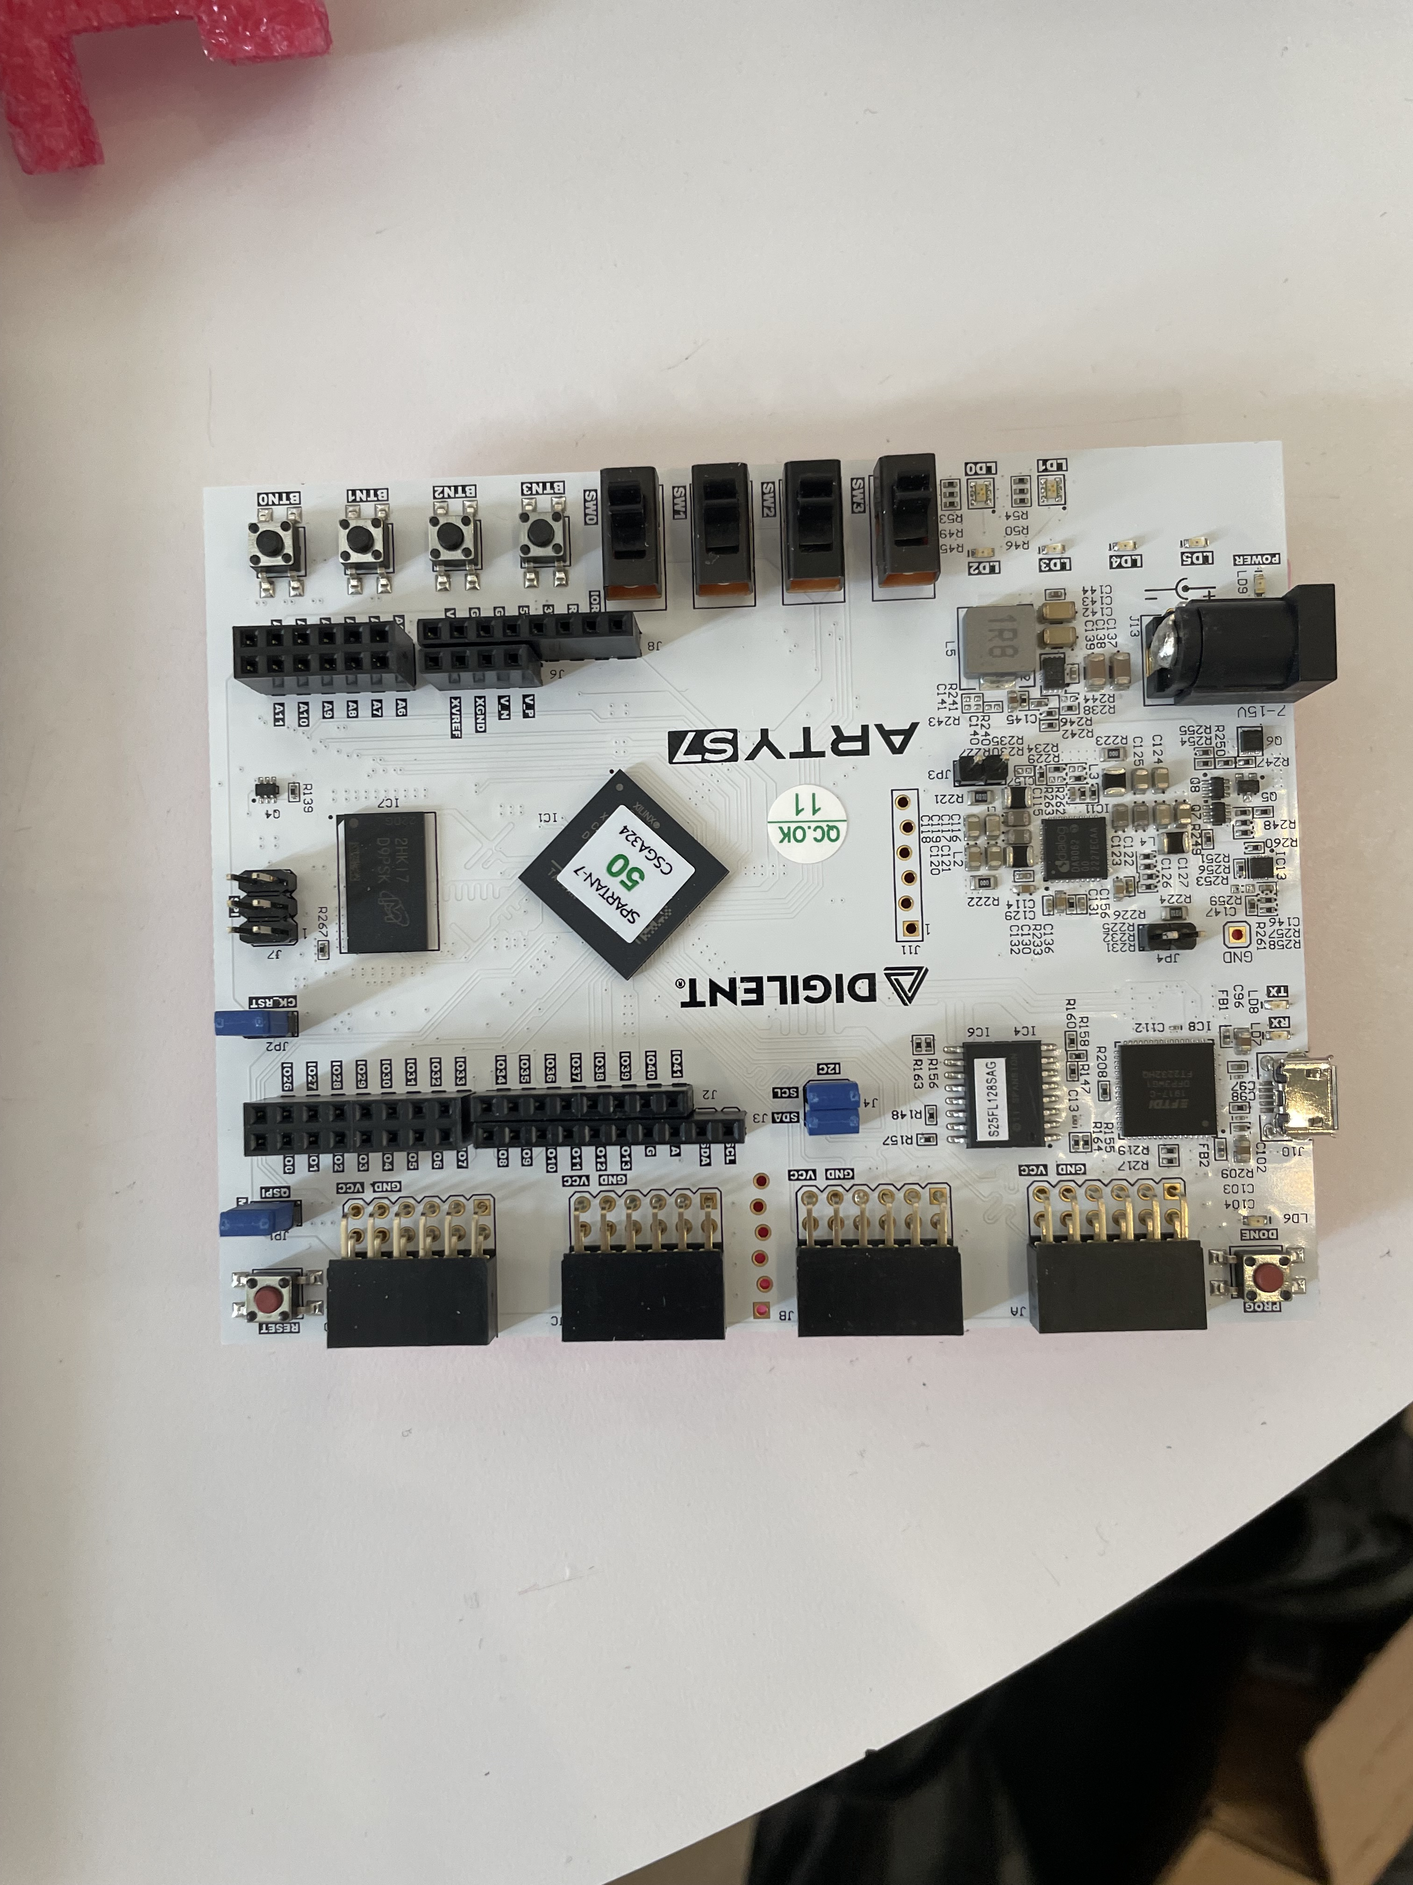
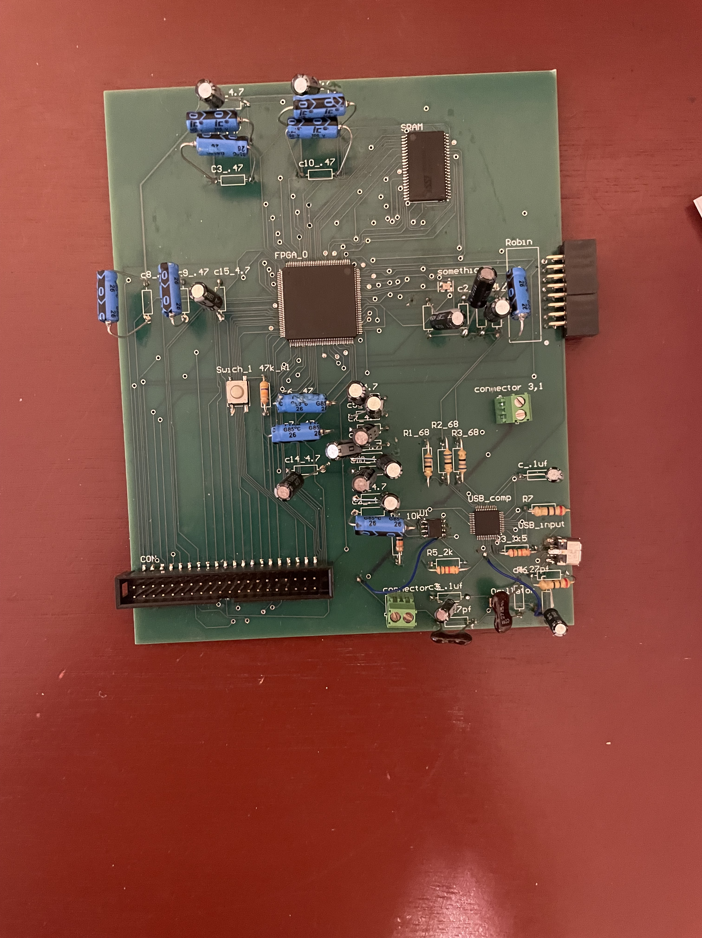
Accomplishments
Original design
New board

Slide 14
FPGA major challenges and solutions
Challenges
Solutions
SPI communication not syncing up
Micro USB not connecting
Challenges connecting to the DAC
Rewriting the Verilog to correct timing errors
Connecting to a 5V power instead of 3.3V
Rewriting the code to more effectively connect to the system

Slide 15
Test Name | Methodology | Status
Simulation | Testing the code between the different modules on the FPGA | PASSED
SPI connection | Connection between the FPGA and the Micro controller | FAIL
Full connection | Connecting between the microcontroller and the DAC through the FPGA | FAIL
DAC connection | The FPGA can correctly read inputs into the DAC | FAIL

Slide 16
DAC & Power System Oscar Medrano

Slide 17
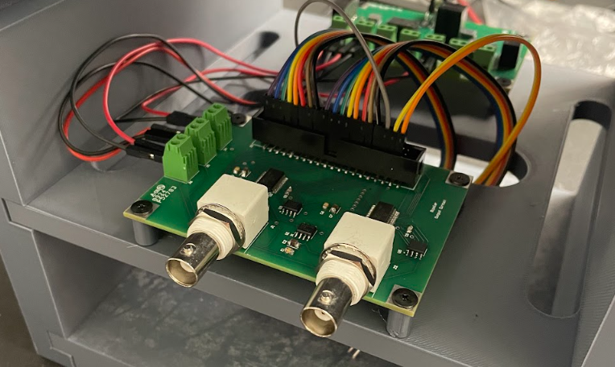
DAC Accomplishments
All ICs receive the correct power input.
Voltage Reference is +10V.
Each DAC can receive 16-bits of data.
Each DAC outputs withing a +/- 10V range.
DAC System PCB in the Enclosure

Slide 18
DAC System
DAC 1
Decimal | Hexadecimal | Voltage [V]
65535 | FFFF | 9.996
60000 | EA60 | 8.308
55000 | D6D8 | 6.782
50000 | C350 | 5.256
45000 | AFC8 | 3.731
40000 | 9C40 | 2.205
35000 | 88B8 | 0.68
30000 | 7530 | -0.845
25000 | 61A8 | -2.371
20000 | 4E20 | -3.896
15000 | 3A98 | -5.422
10000 | 2710 | -6.947
5000 | 1388 | -8.473
2500 | 09C4 | -9.236
1250 | 04E2 | -9.617
625 | 0271 | -9.808
0 | 0000 | -9.998
DAC 2
Decimal | Hexadecimal | Voltage [V]
65535 | FFFF | 9.997
60000 | EA60 | 8.308
55000 | D6D8 | 6.782
50000 | C350 | 5.257
45000 | AFC8 | 3.731
40000 | 9C40 | 2.206
35000 | 88B8 | 0.68
30000 | 7530 | -0.845
25000 | 61A8 | -2.371
20000 | 4E20 | -3.896
15000 | 3A98 | -5.422
10000 | 2710 | -6.947
5000 | 1388 | -8.473
2500 | 09C4 | -9.236
1250 | 04E2 | -9.617
625 | 0271 | -9.808
0 | 0000 | -9.999

Slide 19
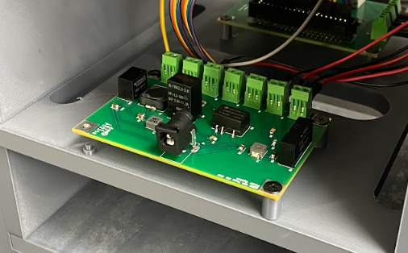
Power System Accomplishments
Adjusted the power jack to be more sturdy
Solution: Solder directly to the board using a short wire
Input voltage powers up each converter and each converter outputs the desired voltage.
Challenge: Issues with the +/- 15V converter.
Solution: Connecting the common pin to ground.
Power System PCB in the Enclosure

Slide 20
Integrated System Results
Test Name | Methodology | Status
Sine | Oscilloscope displays sine wave output | FAILED
Square | Oscilloscope displays square wave output | UNTESTED
Triangle | Oscilloscope displays triangle wave output | UNTESTED
Sawtooth | Oscilloscope displays sawtooth wave output | UNTESTED
Freehand | Oscilloscope displays user drawn wave output | UNTESTED
Notes:
This section shows end-to-end system operation
Show and provide details on a few important end-to-end use scenarios that you developed and validated. Giving results (be quantitative here – results for key performance indicators … time to complete task, overall accuracy of task, success/fail measures)
Oscar

Slide 21
Conclusions
Difficulties with communications between subsystems
Status:
System integrated
Issues with MCU to FPGA connection and FPGA to DAC connection
Debugging these three systems to be completed before final demo
Notes:
List issues encountered that required changes from system described in Conops, FSR/ICD and resulting system design changes
Current status (eg. integration/test/validation complete; Integration complete, but BT comm not fully validated; Repeating testing for replacement PCB, integration/validation to be completed in 1 week)
Nick

Slide 22
Thank you

